Slide 1
Oregon
Home Care Jobs
Make a difference in someone’s life and have the flexibility you need to live yours
Notes:
Home care is a profession that touches most Oregonians in some way, which is one reason there is an increasing demand for home care workers in the state.
A recent study projects that Oregon will need to fill 36,000 job openings in home care by 2030 to meet this demand.

Slide 2

But first, what is Home Care?
A job with a purpose.
The home care profession supports:
Older adults
People of all ages with disabilities
People with behavioral and mental health needs
Working in home care makes a real difference in people’s lives, supporting them with daily tasks like dressing and transportation and daily activities like grocery shopping.
Notes:
This work makes a difference in someone’s life, supporting them to live more independently and direct their own lives.
Days can be hard, physically and emotionally.
And they can also be filled with joy. Many care providers describe moments of laughter, dancing and painting.

Slide 3

There is a need for applicants …
In every county across Oregon
From people of all cultures including those who speak languages other than English
No home care or healthcare experience is needed to apply
Note: this campaign focuses on jobs through the state to support people receiving Medicaid services.
Notes:
There are jobs available in every county across the state, which means that individuals considering applying can work close or in their home communities.
There is a need for applicants from people of all cultures and in all languages. Many people prefer care from someone who share some things in common.
Regardless of whether they have ever worked in home care before or have healthcare experience or training.
The jobs referenced here are through the state as opposed to jobs available for private companies. There are also home care roles to work with private companies that provide care. This campaign, however, is referring to jobs that support individuals already receiving Medicaid support.

Slide 4
There are four types of home care jobs
Apply for more than one!
Homecare Workers | Personal Care Attendants | Personal Support Workers | Personal Support Worker Job Coaches
Support older adults and people with physical disabilities. Help with daily tasks, personal care and mobility to help people live more independently. | Support people with behavioral or mental health needs. Assist with daily living activities, medication reminders and coping strategies. | Support children and adults with intellectual and developmental disabilities (I/DD). Help with daily living, personal care and life skills at home and in their community. | Support people with intellectual and developmental disabilities (I/DD) to get, learn and keep the jobs of their choice in the workplace.
Notes:
Applicants are encouraged to apply for one or more roles as they can work in more than one position at the same time.
Each role supports a different group of people. There are slightly different application processes for each.

Slide 5




Meeting the demand
This campaign will:
Attract and retain home care workers
Deepen people's’ understanding and value of the profession
Notes:
To meet the demand, Oregon Department of Human Services and Oregon Health Authority, have partnered on an effort to be sure people know about the jobs available and make the process to apply as easy as possible.
Home care has been a critical role for centuries, promoting independence, dignity and the highest quality of life possible for the individuals in need of care by offering customized care in familiar settings and creating the conditions for social connection at home or out in the community.
Home care also leads to better health outcomes; It is also less expensive for those receiving care and taxpayers than hospital visits and care in an institution like a nursing home.

Slide 6

The campaign
April 2025 – March 2026
Updated website in eight different languages
Increased accessibility: materials in eight languages, application / enrollment navigators
Social ads on Facebook, Instagram and LinkedIn
Display ads on popular sites online like news, weather and entertainment sites
Ads in popular places like grocery stores, libraries and bus stops
Partnerships and a toolkit to support their efforts
Notes:
The image here is an example of the campaign that you might see on the side of a bus shelter. The QR code directs people back to the website.

Slide 7

Why choose Home Care?
Flexibility in hours and days worked
Benefits like overtime and health insurance
Free — and sometimes paid — training* to:
  Earn certifications that lead to higher pay
  Learn the skills you need to do the job well
  Get experience to start a new or different career
*Most trainings are available online and in person and have interpretation services.
Notes:
The Home Care profession offers perks.
In addition to working in a field with a purpose, home care work provides flexibility. Home care professionals can choose who they work with and set their hours and schedules with the people they support.
The roles offer overtime and paid time off, and healthcare and retirement savings options. Hourly pay increases are available based on the number of hours worked or with additional certifications attained.
Free training ensures people feel comfortable and confident in the role. They also provide hours / experience needed to jumpstart a first-time or new career. For some trainings you are paid when you attend.
Other benefits include:
Overtime pay
Dental and vision coverage
An Employee Assistance Program
OregonSaves retirement savings account
These home care roles start at $20 an hour— more than minimum wage.
*Most trainings are available online and in person and have interpretation services.

Slide 8
People already providing care …
Can access free and additional resources and training opportunities to grow their skills.
Who are not certified may be eligible to get a provider number and paid for their work if the person they are supporting receives Medicaid-funded services and support.

Slide 9

Jumpstarting careers
Home Care can be a lifelong career, a part-time job or a jumpstart into a new or different line of work.
Home care can provide experience for careers in:
Health and healthcare like nursing, medical technicians and medical assistants
Mental / behavioral health like social work and counseling
Education including specialties for students with disabilities

Slide 10
Eligibility:
Applicants must:
Be 18 years old or over
Live in Oregon or within 75 miles of the Oregon border
Be authorized to work in the
United States
Pass a background check*
*Not all convictions prevent hiring
Notes:
Below are the potentially disqualifying convictions and abuse history that might keep someone from working in home care:​​
List of potentially disqualifying crimes for providers
List of potentially disqualifying abuse for providers
Weighing test for providers with PDQs

Slide 11

Website with materials in multiple languages
Notes:
The updated website also offers materials in multiple languages.
It has resources for applicants and also for people already working in home care.

Slide 12
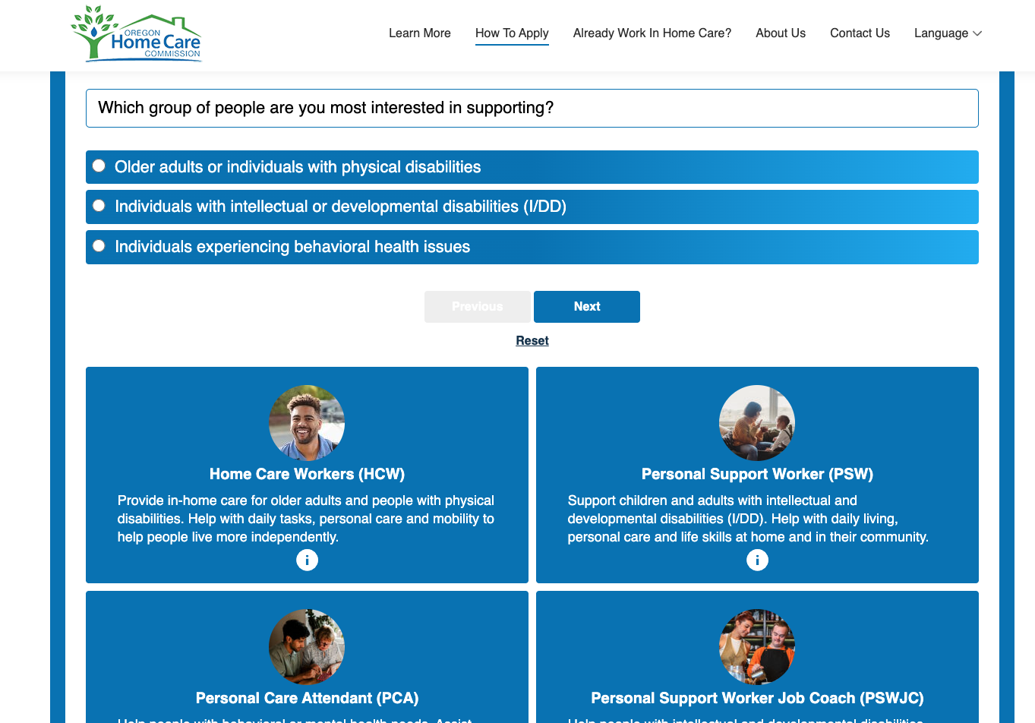
About OregonHomeCareJobs.com
Find information about the different roles and directions for applying
Confirm eligibility
Take a quiz to determine which home care roles best fit them
Get step-by-step information about the application process – including a general timeline – before starting
Watch a video of a typical day of a home care professional in the role of their choice
Access the website in eight different languages

Slide 13
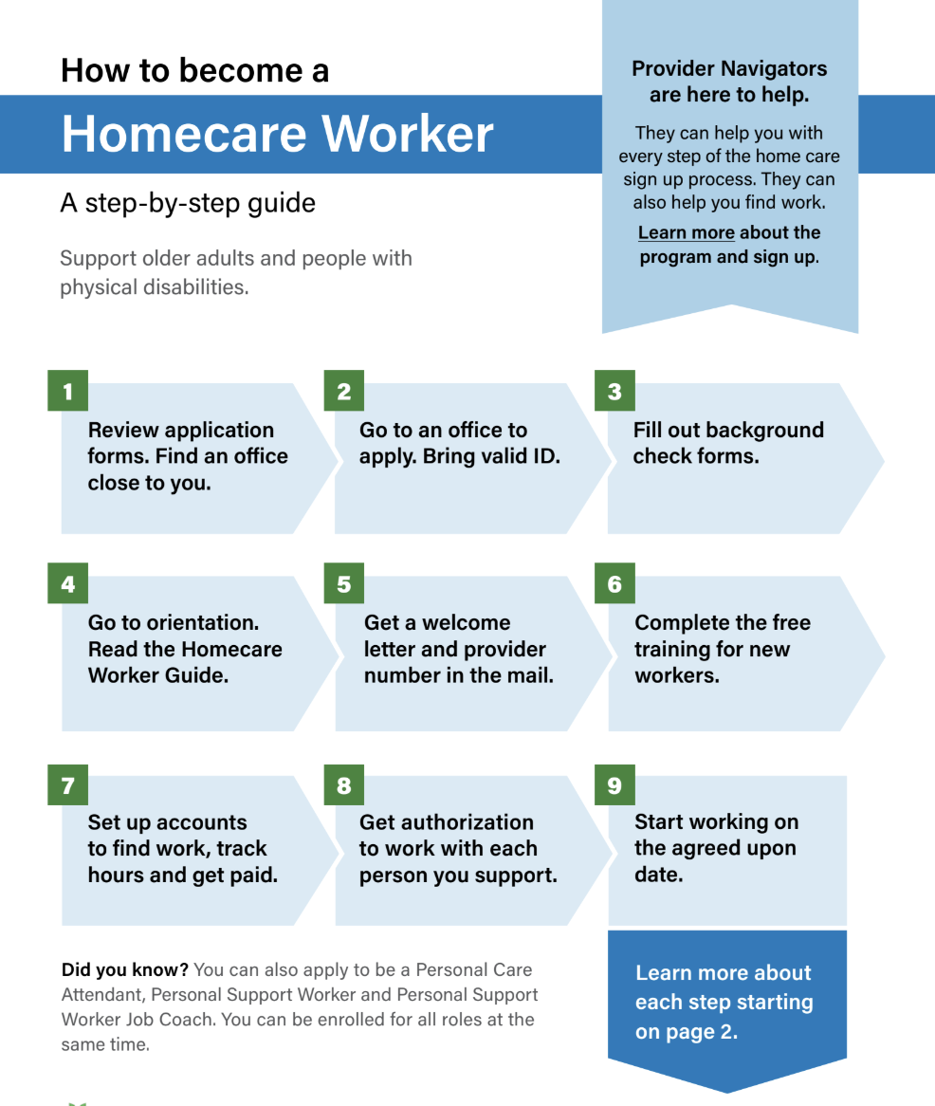
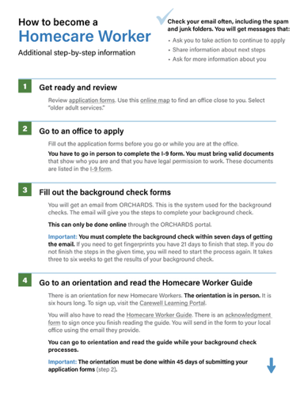
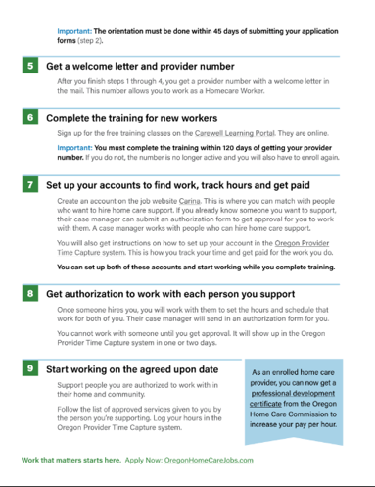
Application Guides available in:
English
Spanish
Russian
Vietnamese
Simplified Chinese
Korean
Somali
Arabic
Notes:
On the website, there are step by step guides for each of the career options, as pictured here.
There are important steps to pay attention to like the time frame in which the applicant must complete orientation.
The step by step guide also provides tips like checking your email often as most communication goes through email and it can get lost in junk or spam folders.

Slide 14
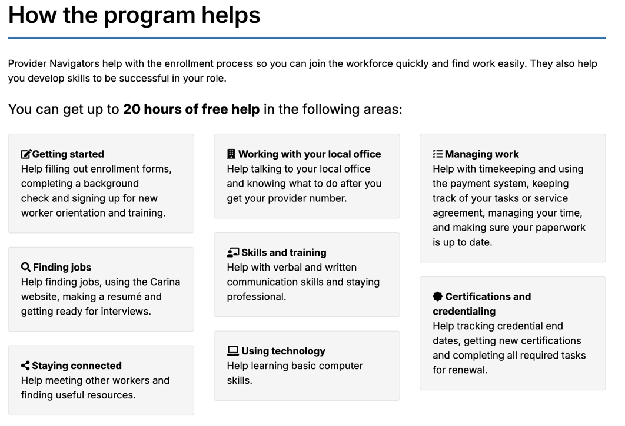
Provider Navigator Program
Free one-on-one guidance for new and existing workers to help with:
the application and enrollment process
finding work
accessing help in multiple languages
Oregon.gov/odhs/providers-partners/homecare-workforce/Pages/navigator.aspx
Notes:
There are personal coaches to provide free support with the application process, finding jobs and more. Click here to access additional information about the Provider Navigator Program.

Slide 15
Helping to share the opportunity – thank you!
Find the online toolkit at OregonHomeCareJobs.com/PartnerToolkit
Materials available for download or printing:
Poster
Flyer
Wallet card
Job description
Step-by-step applicant guides
Customizable materials for sharing:
Newsletter content
Email copy
Talking points
PowerPoint Presentation (this one!)
Notes:
The campaign is grateful for people and organizations willing to share information with their networks, either those consisting of prospective applicants or people who might refer others to apply.
The online toolkit is available at www.OregonHomeCareJobs.com/toolkit.
Some current campaign collaborators are career specialists at community colleges, people from the Oregon Office of Rural Health, the Coalition of Local Health Officials, members of various WorkSource offices across the state, and others.

Slide 16


Thank you!
Applications:
OregonHomeCareJobs.com TrabajosDeCuidadoSaludOregon.com/
Partner tools:
OregonHomeCareJobs.com/PartnerToolkit

